Slide 1
Office Of Assessment
Arthur Thomas and steve lochmann

Slide 2
What is Assessment
Assessment involves the use of student learning data to refine programs and improve outcomes.
Institutions and programs explicitly state student learning outcomes (SLOs).
Patterns of student learning are examined across courses and programs. This information is used to improve educational practices.

Slide 3
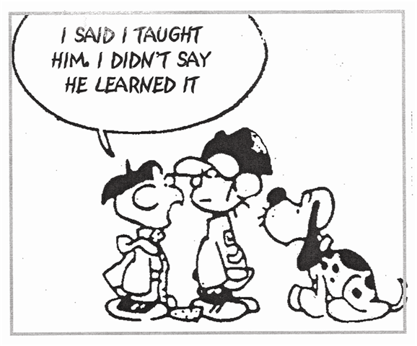
Assessment is NOT…
Grading. Grades alone are insufficient evidence of student learning..
Testing. Testing describes only one step in the assessment process, namely gathering and analyzing evidence of achievement of student learning outcomes.
Notes:
Grading not our business

Slide 4
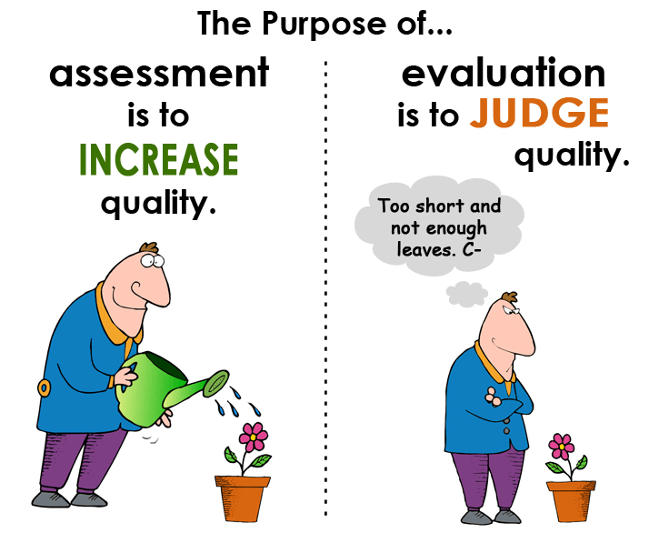
Why we are here
Not here to point fingers
Not controlling the way you run your class
We’re here for CONTINUOUS improvement of student learning.
Fulfill HLC Criteria 4

Slide 5
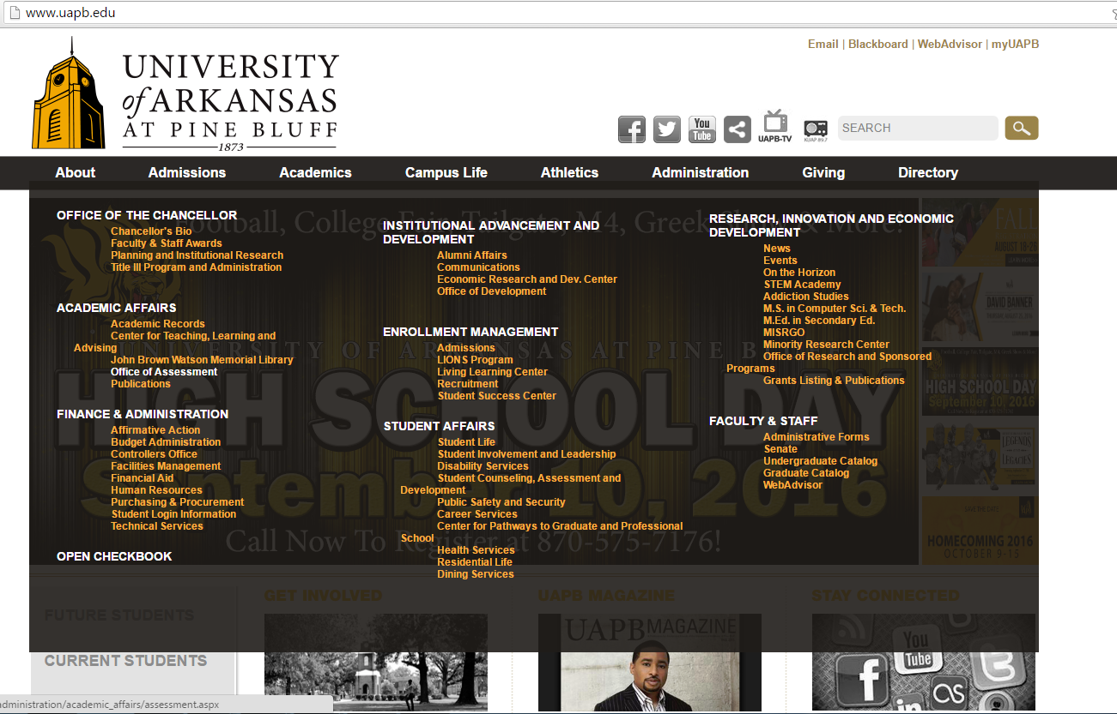
Assessment Website
http://www.uapb.edu/administration/academic_affairs/assessment.aspx

Slide 6
Institutional SLO’s
Reading
Written Communication
Oral Communication
Critical Thinking
Teamwork
Problem Solving
Foundations and Skills for Lifelong Learning

Slide 7
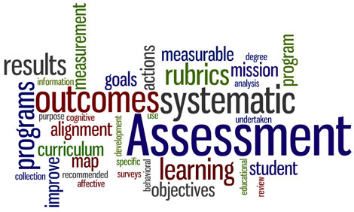
Rubric Based Assessment
Direct Assessment
Tangible Artifact
AAC&U Value rubrics
University wide
School wide
Degree Program SLOs
Notes:
Aacu examples()

Slide 8
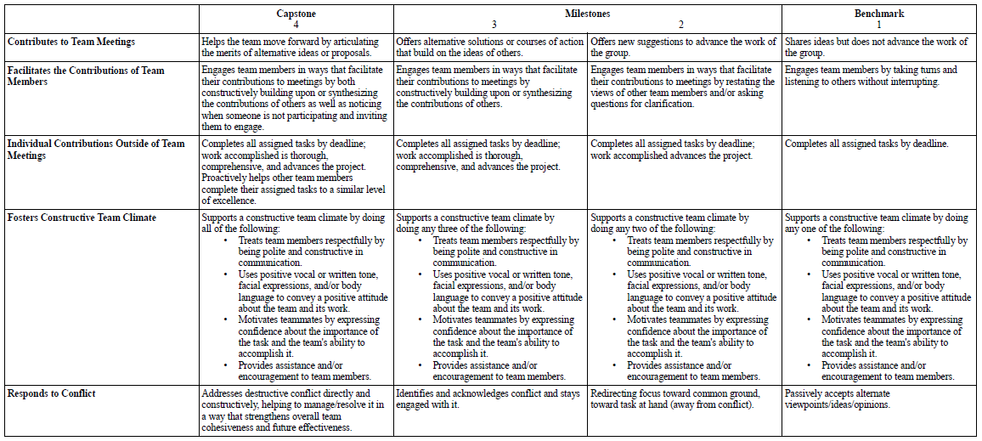
AAC&U Teamwork Rubric

Slide 9
AAC&U Teamwork Rubric

Slide 10
What is LiveText
Assessment Management System
Repository of key assessments
Archives Artifacts
Accredited/licensed/state certified academic units to fulfill their assessment requirements
www.livetext.com

Slide 11
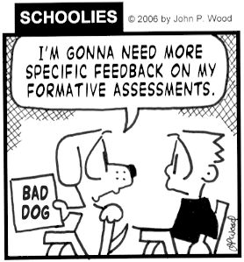
How we use LiveText
Instructors use LT to assess an assignment where students demonstrate skills relative to a SLO
Create reports and analyze data from the assessments
Reports sent to departments so that challenges can be addressed

Slide 12
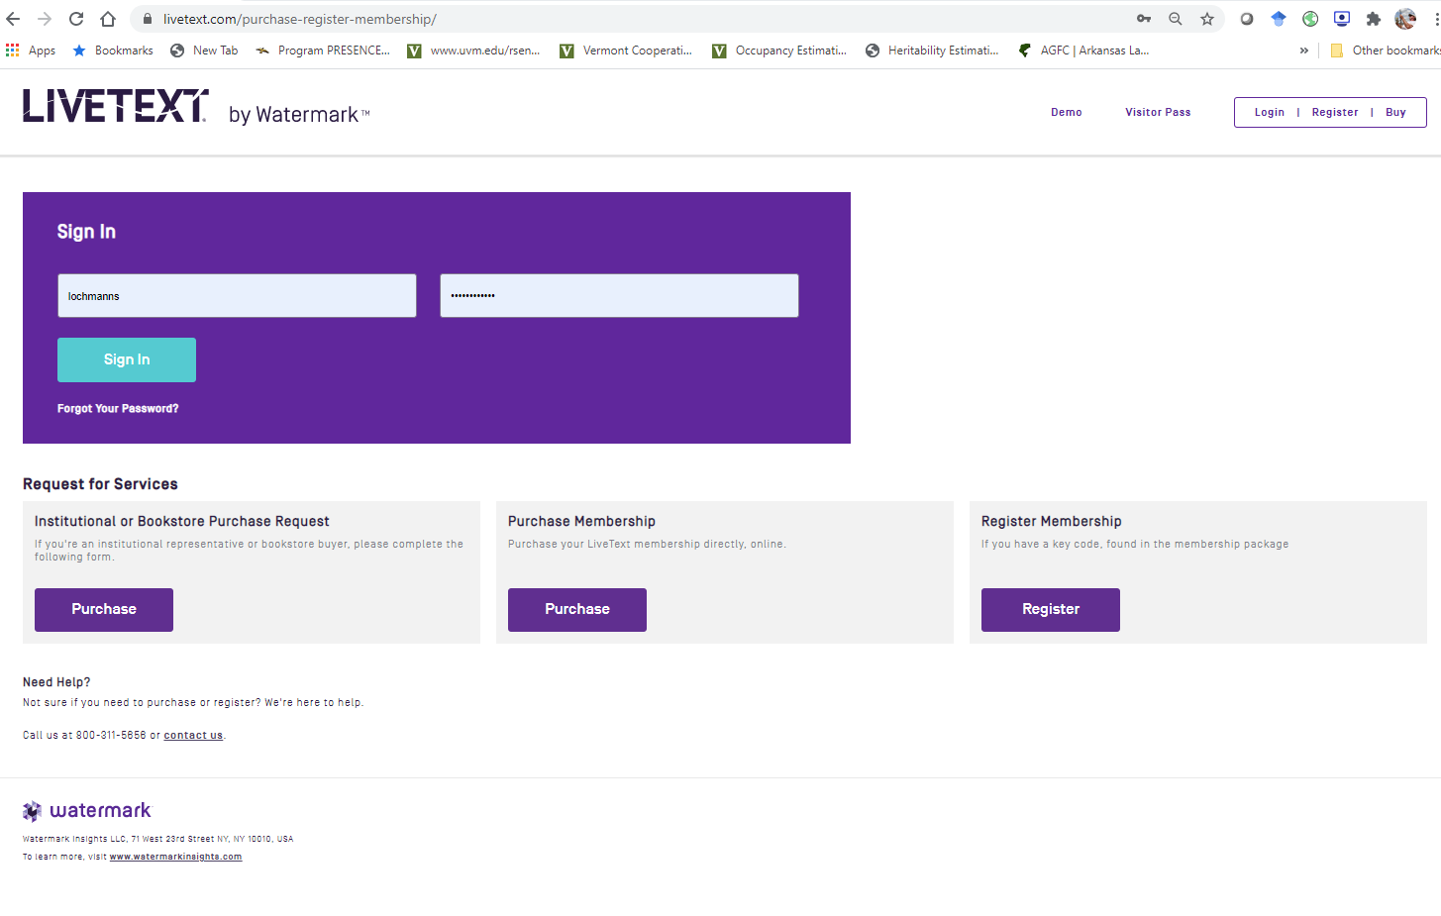
How we use LiveText

Slide 13
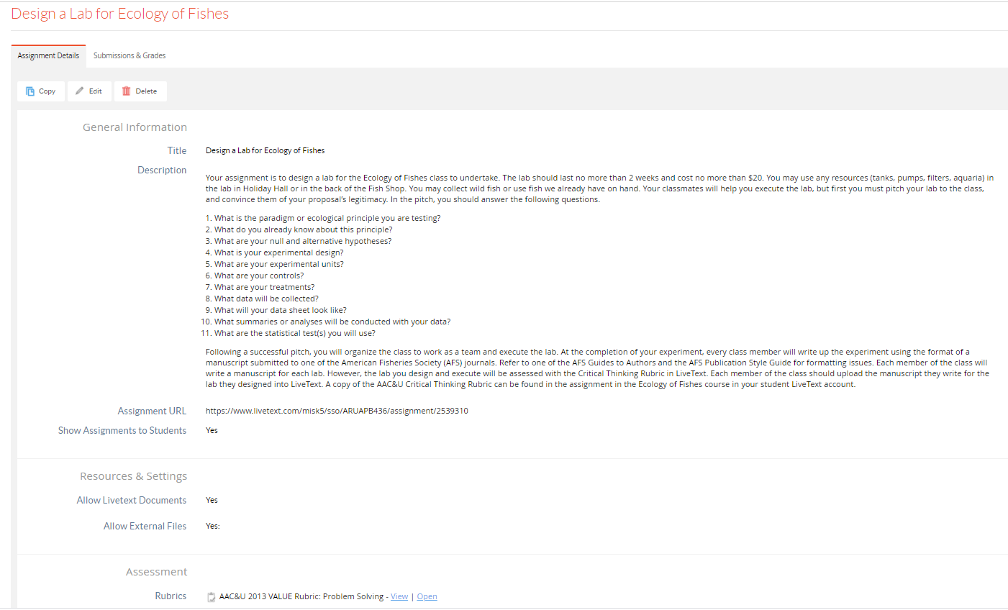
How we use LiveText

Slide 14
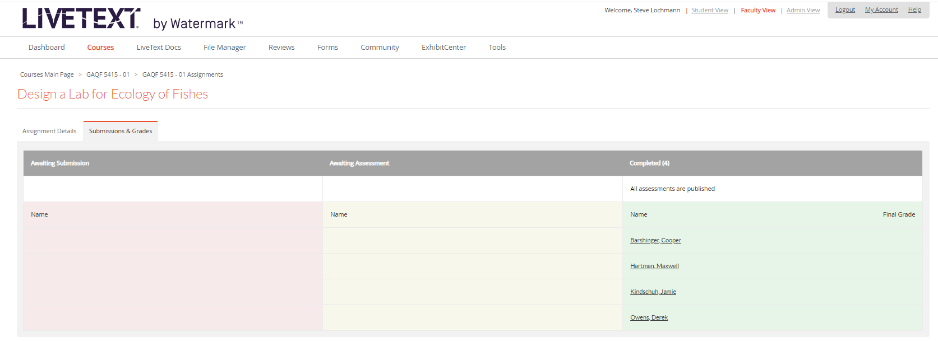

Slide 16
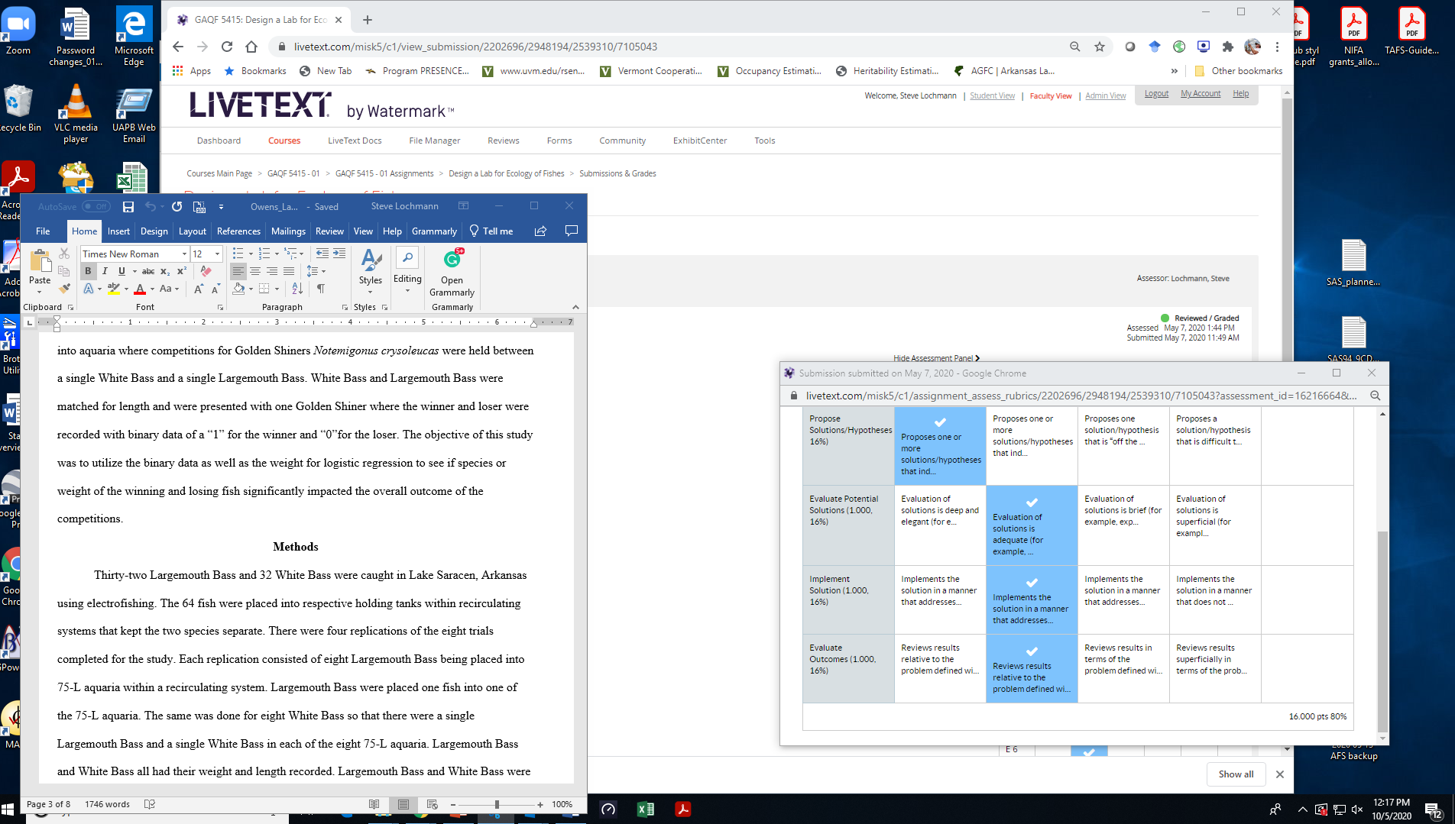

Slide 17
LT Training Sessions
LiveText Training Sessions
Navigation
Edit of an Assignment
Rubric based Assessment of SLO

Slide 18
Contact Us
Arthur Thomas, LiveText Administrator Office of Assessment thomasa@uapb.edu 870-575-8173
Steve Lochmann, Director Office of Assessment assessment@uapb.edu 870-575-8170

